Slide 1


Cool Tshirts
Attribution Queries and Analysis
Learn SQL from Scratch
Connie Stovall
October 12, 2018

Slide 2
Table of Contents
1. Get familiar with CoolTShirts
2. User Journey Analysis
3. Campaign Budget Optimization

Slide 3
Getting Familiar with CoolTShirts

Slide 4
Understanding Cool Tshirts Marketing Campaigns
How many campaigns and sources does CoolTShirts use and how are they related?
Be sure to explain the difference between utm_campaign and utm_source.
CoolTshirts employs 8 campaigns via 6 sources.
Sources are the medium by which campaign ads are provided to potential customers.
For instance, a customer reading the The New York Times, a source, will encounter an ad campaign called “getting to know cool tshirts.”
What pages are on the CoolTShirtswebsite?
1 - landing_page | 2 - shopping_cart | 3 - checkout | 4 - purchase

Slide 5
Getting Familiar with CoolTshirts: The Queries
1. Campaigns
8
4. Page Name
1 - landing_page
2 - shopping_cart
3 - checkout
4 - purchase
1. To count the distinct types of campaign:
select count (distinct utm_campaign)
from page_visits;
2. To count the distinct types of sources:
select count (distinct utm_source)
from page_visits;
3. To find how campaigns and sources are related:
select distinct utm_source, utm_campaign
from page_visits;
4. To find pages on the CoolTshirts website:
select distinct page_name
from page_visits;
2. Sources
6
3. Sources | Campaigns
nytimes | getting-to-know-cool-tshirts
email | weekly-newsletter
buzzfeed | ten-crazy-cool-tshirts-facts
email | retargetting-campaign
facebook | retargetting-ad
medium | interview-with-cool-tshirts-founder
google | paid-search
google | cool-tshirts-search

Slide 6
User Journey Analysis

Slide 7
How Many First Touches is each Campaign Responsible?
The query includes creating temporary tables called first_touch and ft_attr. The last_touch table involves using the minimum timestamp, or first touch. After creating the temporary tables, a join was made on the existing table called page_visits. This allowed for counting the number each first touch per campaign.
WITH first_touch AS (
SELECT user_id,
MIN(timestamp) as first_touch_at
FROM page_visits
GROUP BY user_id),
ft_attr AS (
SELECT ft.user_id,
ft.first_touch_at,
pv.utm_source,
pv.utm_campaign
FROM first_touch ft
JOIN page_visits pv
ON ft.user_id = pv.user_id
AND ft.first_touch_at = pv.timestamp)
SELECT ft_attr.utm_source,
ft_attr.utm_campaign,
COUNT(*)
FROM ft_attr
GROUP BY 1, 2
ORDER BY 3 DESC;
Source | Campaign | Count
medium | interview-with-cool-tshirts-founder | 622
nytimes | getting-to-know-cool-tshirts | 612
buzzfeed | ten-crazy-cool-tshirts-facts | 576
google | cool-tshirts-search | 169

Slide 8
How Many Last Touches is Each Campaign Responsible?
The query includes creating temporary tables called last_touch and lt_attr. The last_touch table involves using the maximum timestamp, or last touch. After creating the temporary tables, a join was made on the existing table called page_visits. Source and campaign columns were selected and counted. This allowed for counting the number of each last touch by each campaign.
WITH last_touch AS (
SELECT user_id,
MAX(timestamp) as last_touch_at
FROM page_visits
GROUP BY user_id),
lt_attr AS (
SELECT lt.user_id,
lt.last_touch_at,
pv.utm_source,
pv.utm_campaign
FROM last_touch lt
JOIN page_visits pv
ON lt.user_id = pv.user_id
AND lt.last_touch_at = pv.timestamp)
SELECT lt_attr.utm_source,
lt_attr.utm_campaign,
COUNT(*)
FROM lt_attr
GROUP BY 1, 2
ORDER BY 3 DESC;
Source | Campaign | Count
medium | interview-with-cool-tshirts-founder | 622
nytimes | getting-to-know-cool-tshirts | 612
buzzfeed | ten-crazy-cool-tshirts-facts | 576
google | cool-tshirts-search | 169

Slide 9
How Many Visitors Make a Purchase?
The query includes counting the distinct number of user id’s from the table “page_visits” where “4 – purchase” occurs in the “page_name column.”
select count (distinct user_id)
from page_visits
where page_name = '4 - purchase';
Count Distinct User Id
361

Slide 10
How Many Last Touches on the Purchase Page is Each Campaign Responsible?
The query includes counting the distinct number of user id’s from the table “page_visits” where “4 – purchase” occurs in the “page_name column.”
with last_touch as (
select user_id,
max(timestamp) as last_touch_at
from page_visits
where page_name = '4 - purchase'
group by user_id),
ft_attr as (
select lt.user_id, lt.last_touch_at, pv.utm_source, pv.utm_campaign
from last_touch lt
join page_visits pv
on lt.user_id = pv.user_id
and lt.last_touch_at = pv.timestamp)
select ft_attr.utm_source, ft_attr.utm_campaign,
count (*)
from ft_attr
group by 1, 2
order by 3 desc;
Source | Campaign | Count
email | weekly-newsletter | 115
facebook | retargetting-ad | 113
email | retargetting-campaign | 54
google | paid-search | 52
buzzfeed | ten-crazy-cool-tshirts-facts | 9
nytimes | getting-to-know-cool-tshirts | 9
medium | interview-with-cool-tshirts-founder | 7
google | cool-tshirts-search | 2

Slide 11
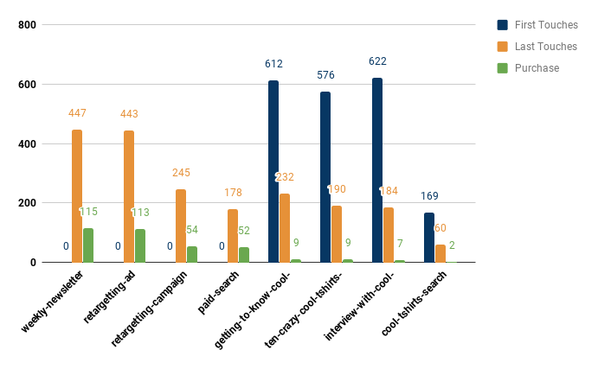
What is the Typical User Journey?
The top 3 campaigns as demonstrated through last touches show no overlap with the top 3 campaigns associated with the top 3 first touches. The top 3 last touch campaigns also earned the top 3 in purchases.
All users first encounter 1 of 4 different ad campaigns (their first touch) via Google, The New York Times, Buzzfeed, and Medium. Those users’ last touch is spread across 8 campaigns, however. While some users may “last touch” the same campaign they encountered the first time, many more encounter new ads targeting toward them in email, Facebook, and Google. All of these latter mentioned campaigns appear much more effective in instigating an actual purchase. These campaigns account for 92.5% of all purchases.

Slide 12
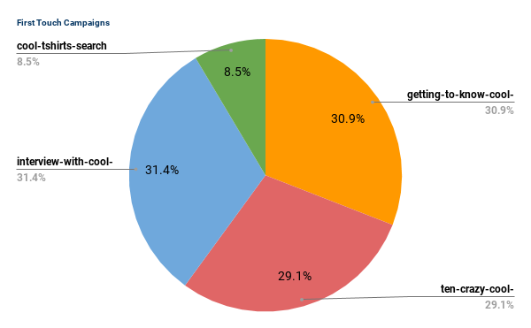
First Touch Campaigns
All first touches occurred through just 4 campaigns. Sources were NY Times, BuzzFeed, Medium, and Google.

Slide 13
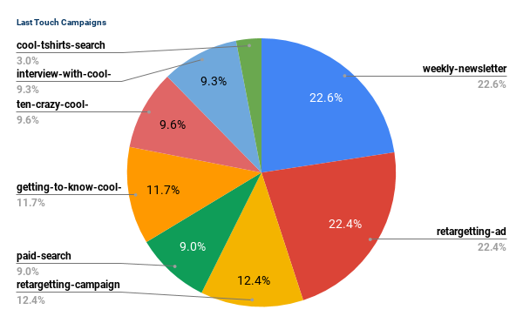
Last Touch Campaigns
The top 4 campaigns with last touches account for 57.4% of all last touches. Only 1 of these campaigns saw first touches: Getting to Know CoolTshirts from the NY Times.

Slide 14
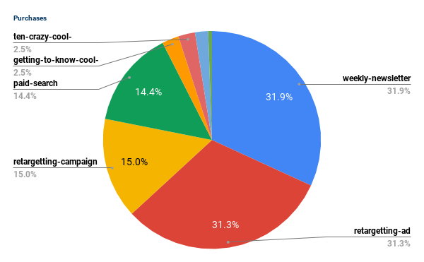
Campaigns Associated with Purchases
The top 4 campaigns associated with purchases account for 92.5% of all purchases. Almost half, 46.8% derived from email sources.

Slide 15
Campaign Budget Optimization

Slide 16
Optimize the Campaign Budget
Cease funding for the following campaign: CoolTshirts Search.
Reallocate funds from that campaign to more re-targeting campaigns via email and social media.
Could be beneficial to create re-targeting campaigns specifically to Medium and NY Times Campaigns because both incur a large share of first touches.
Sources | Campaign | First Touches | % FT | Last Touches | % LT | Purchase | % Purchase
email | weekly-newsletter | 0 | 0.0% | 447 | 22.6% | 115 | 31.9%
facebook | retargetting-ad | 0 | 0.0% | 443 | 22.4% | 113 | 31.3%
email | retargetting-campaign | 0 | 0.0% | 245 | 12.4% | 54 | 15.0%
google | paid-search | 0 | 0.0% | 178 | 9.0% | 52 | 14.4%
nytimes | getting-to-know-cool-tshirts | 612 | 30.9% | 232 | 11.7% | 9 | 2.5%
buzzfeed | ten-crazy-cool-tshirts-facts | 576 | 29.1% | 190 | 9.6% | 9 | 2.5%
medium | interview-with-cool-tshirts-founder | 622 | 31.4% | 184 | 9.3% | 7 | 1.9%
google | cool-tshirts-search | 169 | 8.5% | 60 | 3.0% | 2 | 0.6%

